Slide 1
SEER*DMS Communications
Survey Findings

Slide 2

First, thank you to survey respondents.

Slide 3
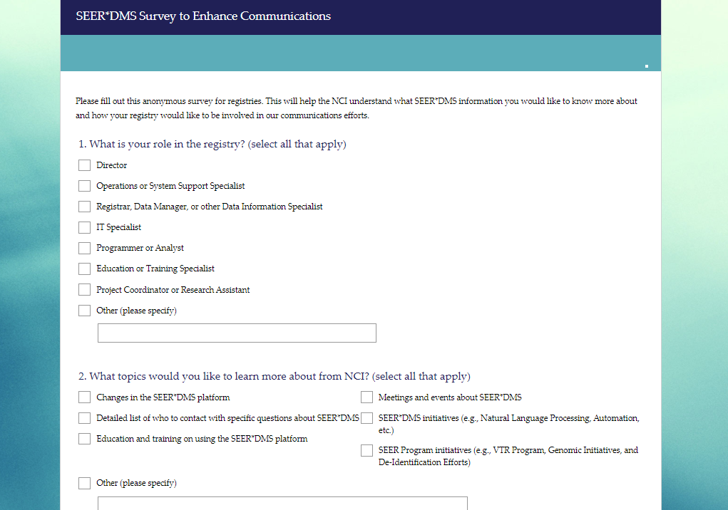

Slide 4
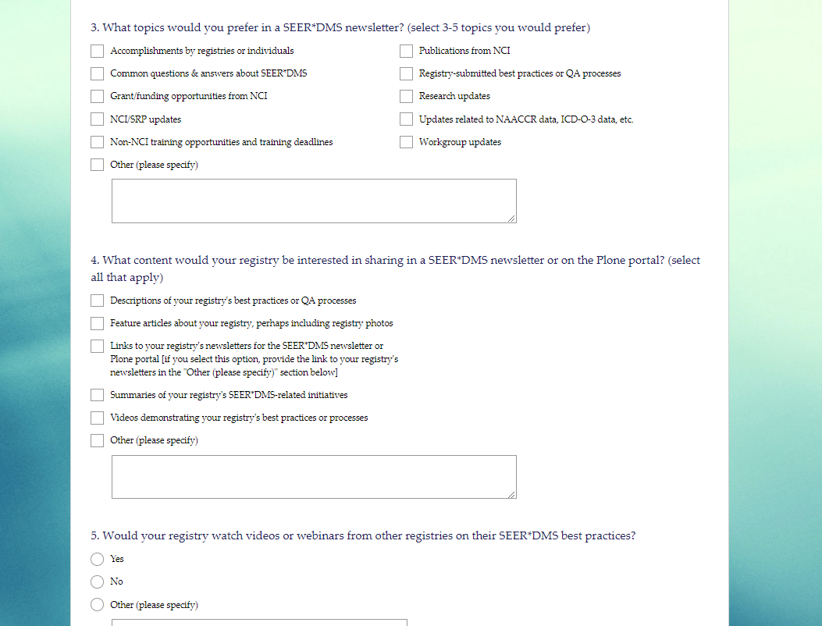

Slide 5
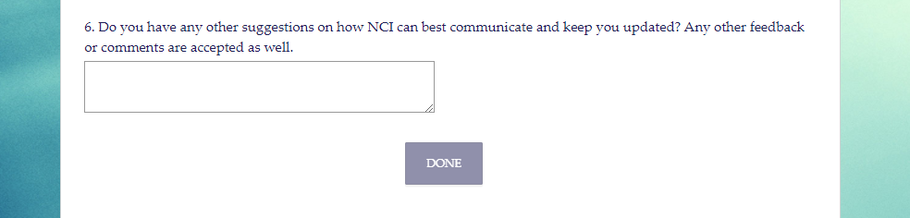

Slide 6

Communications Survey Findings
PIs/ Directors/Operations Managers want to know about higher-level SEER*DMS and NCI/SRP topics
Registrars/Data & IT Specialists/ Programmers/ Analysts want to know about SEER*DMS changes that directly affects their work
Registries are willing to share descriptions of their registry best practices or QA processes and summaries of their registry’s SEER*DMS-related initiatives

Slide 7
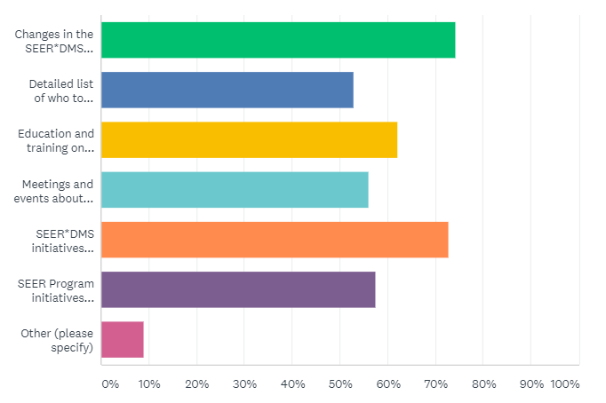
Question: What topics would you like to learn more about from NCI? (select all that apply) (n=66)
Higher-Level Topics vs. Technical Information

Slide 8
Question: What topics would you like to learn more about from NCI? (select all that apply) (n=66)
Higher-Level Topics vs. Technical Information
Role Type | Changes in the SEER*DMS platform | Detailed list of who to contact with specific questions about SEER*DMS | Education and training on using the SEER*DMS platform | Meetings and events about SEER*DMS | SEER*DMS initiatives | SEER Program initiatives
PIs/ Directors/ Operations Managers | 72% | 45% | 64% | 55% | 91% | 77%
Registrars/ Data & IT Specialists/ Programmers/ Analysts/+More | 75% | 57% | 61% | 57% | 64% | 48%

Slide 9
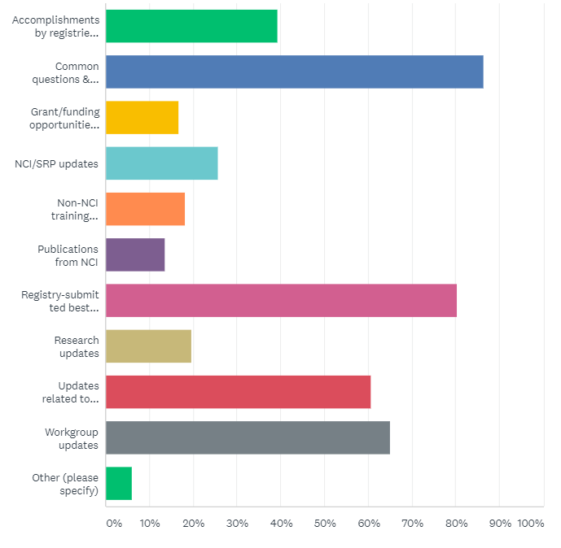
Question: What topics would you prefer in a SEER*DMS newsletter? (select 3-5 topics you would prefer)
Higher-Level Topics vs. Technical Information

Slide 10
Question: What topics would you prefer in a SEER*DMS newsletter? (select 3-5 topics you would prefer)
Higher-Level Topics vs. Technical Information
Role Type | Accomplish-ments by registries or individuals | Common questions & answers about SEER*DMS | Grant/funding opportunities from NCI | NCI/SRP updates | Non-NCI training opportunities and training deadlines
PIs/ Directors/ Operations Managers | 36% | 82% | 18% | 36% | 18%
Registrars/ Data & IT Specialists/ Programmers/ Analysts/+More | 41% | 89% | 16% | 20% | 18%

Slide 11
Question: For those interested in common questions & answers about SEER*DMS, what does common Q&As mean for you? (e.g., are these common Q&As about technical topics or management topics?)
CCB POLL Q. #1

Slide 12
Question: What topics would you prefer in a SEER*DMS newsletter? (select 3-5 topics you would prefer) (continued)
Higher-Level Topics vs. Technical Information
Role Type | Publications from NCI | Registry-submitted best practices or QA processes | Research updates | Updates related to NAACCR data, ICD-O-3 data, etc. | Workgroup updates
PIs/ Directors/ Operations Managers | 18% | 82% | 14% | 59% | 73%
Registrars/ Data & IT Specialists/ Programmers/ Analysts/+More | 11% | 80% | 23% | 61% | 61%

Slide 13
Question: For those interested in workgroup updates, what kind of updates specifically are you looking for? (e.g., updates about project roadmaps, the technical overview, or something else?)
CCB POLL Q. #2

Slide 14
Registries are willing to share best practices and information on SEER*DMS-related initiatives
Registries are willing to share:
Descriptions of their best practices or QA processes (73%)
Summaries of their SEER*DMS-related initiatives (46%)
Feature articles about their registry, perhaps including registry photos (22%)
Links to registry newsletters (12%)

Slide 15
Question: About 73% of respondents indicated their registry would be willing to share descriptions of best practices or QA processes– Are there any specific processes or best practices you’d like to see in the first newsletter?
CCB POLL Q. #3

Slide 16
Other Findings
Sharing best practices by video or by discussion at existing SEER*DMS meetings
Thank you for submitting additional feedback/comments
Feedback related to SEER Manager’s call or quality projects

Slide 17
Question: For creating SEER*DMS best practices videos, would you or anyone at your registry be willing to work with NCI and IMS to create these videos?
CCB POLL Q. #4

Slide 18
Next Steps
Incorporate findings into communications strategy
Determine methods to better share practices among the SEER*DMS community
Determine methods to enhance SEER*DMS training
Reach out to registries that would like to share best practices and summaries of their SEER*DMS initiatives in the SEER*DMS newsletter or portal

Slide 19
Contacts
Administrative questions: seerdms@nih.gov
Questions related to meetings, SEER*DMS F2F, large initiatives
NCI will monitor these questions
Technical questions: https://squishlist.com/seerdms/
Change requests, issues, technical specifications
IMS will monitor these questions

Slide 20
Questions or Comments?
Presenter Contact Information
Alyssa Wang
alyssa.wang@nih.gov

