Slide 1
Data Quality Audit on Melanoma Tumor Depth

Slide 2
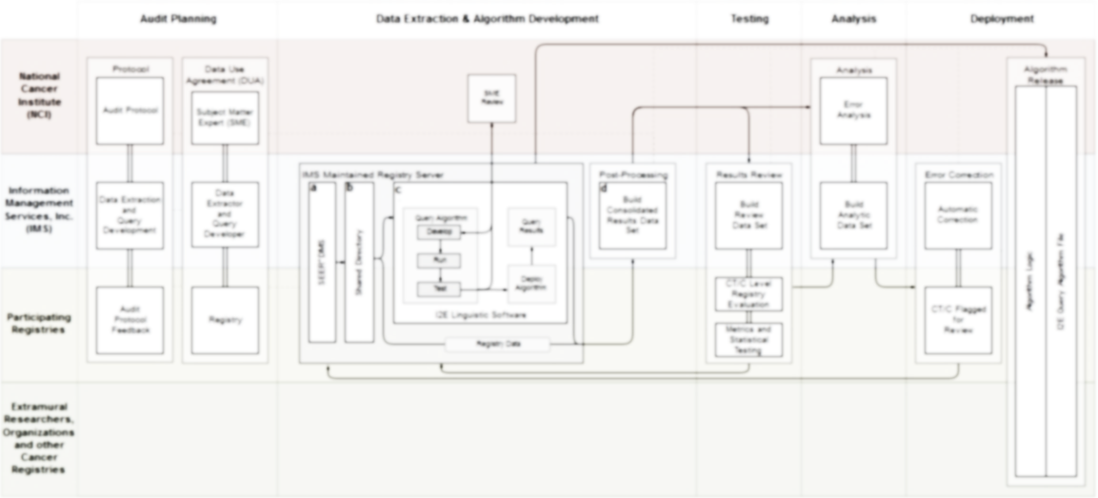
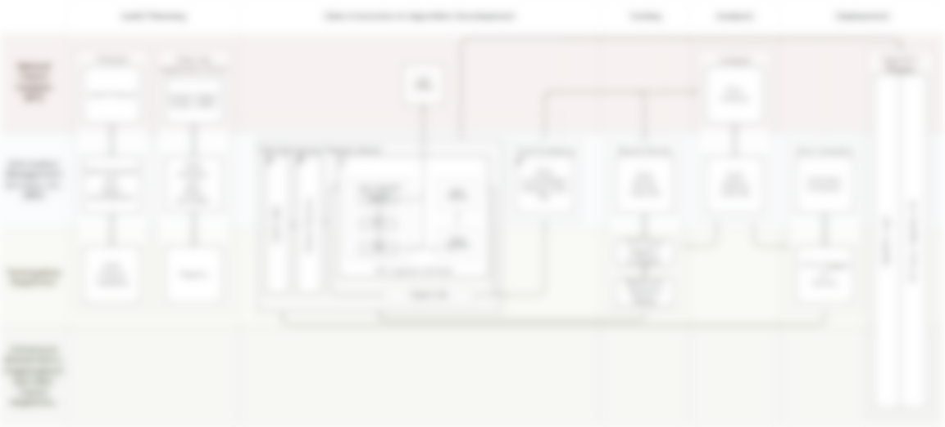
Data Quality Audit
Melanoma Tumor Depth
Clara Lam | Glenn Abastillas | Serban Negoita
Linda Coyle | Jennifer Stevens
Xiao-Cheng Wu | Mei-Chin Hsieh

Slide 3

Audit Goals
Develop & Test
Develop and test algorithm to identify accurate melanoma depth values.
Conduct Assessment
Conduct assessment of error distribution and effect on stage and survival.
Flag Cases
Provide registries with a set of flagged cases for review.
Algorithm & Queries
Disseminate algorithm logic and query file to cancer surveillance and clinical research community.
Automatic Corrections
Provide registries with a method for automatic error correction.
Training Materials
Provide evidence based input for training materials for registrars.

Slide 4
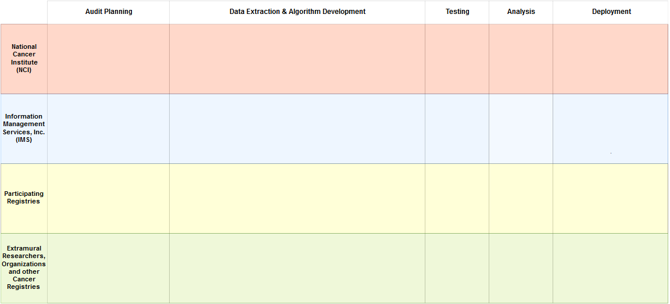
Data Quality Audit Process
A
B
C
D
E

Slide 5

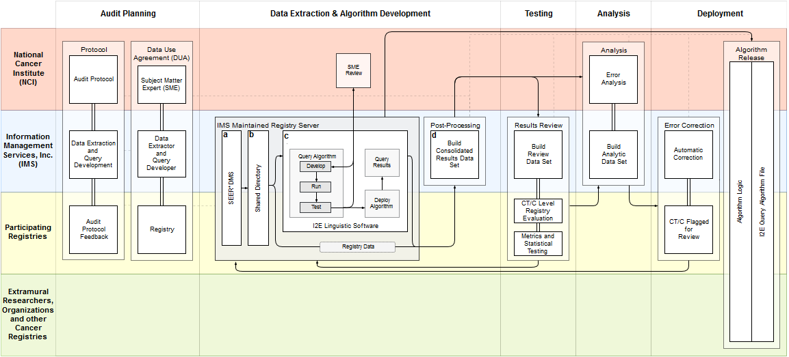
Audit Planning
Protocol Development
Audit process protocol
Selection criteria
Draft query logic
Testing and analysis plans
Deployment
A
B
C
D
E
Data Use Agreements
SMEs at NCI to review results during query development
Assess algorithm performance
A
B
C
D
E

Slide 6
1/2
Selection Criteria
X
SEER Reportable
X
No “Death Certificate Only”
X
Diagnosis from 2010 to 2014
Notes:
Selection Criteria 1 of 2:
SEER Reportable
Exclude death certificates
Time: Diagnosis from 2010 to 2014

Slide 7
1/2
2/2
Selection Criteria
Selection Criteria
  CTC Codes
X
X
Behavior: 3
SEER Reportable
X
X
No “Death Certificate Only”
Primary Site = C44.X
X
X
Histology = 8720 – 8790
Diagnosis from 2010 to 2014
Notes:
Selection Criteria 2 of 2:
Behavior = 3
Defined as “3 = Malignant, Primary Site”
Primary Site = C44.x
Histology = 8720 – 8790
Nodular melanoma (C44._)
Amelanotic melanoma (C44._)
Malignant melanoma, NOS (C44.0_)
Balloon cell melanoma (C44._)
Malignant melanoma, regressing (C44._)
Dysplastic nevus, malignant (C44._)
Lentigo maligna melanoma (C44._)
Superficial spreading melanoma (C44._)
Desmoplastic melanoma, malignant (C44._)
Mucosal lentiginous melanoma (C44._)
Epithelioid cell melanoma (C44._)
Blue nevus, malignant (C44._)
Spindle cell melanoma, NOS (C44._)
Cellular blue nevus, malignant (C44._)
Malignant melanoma in junctional nevus (C44._)
Malignant melanoma in precancerous melanosis (C44._)
Acral lentiginous melanoma, in malignant (C44._)
Malignant melanoma in giant pigmented nevus (C44._)
Mixed epithelioid and spindle cell melanoma (C44._)

Slide 8
Data
5380
Reports
4212
Abstracts
Pathology Reports
<█ ██ █>
<██ █ ██/>
Abstracts
<█ ██ █>
<█ ██ █>
█ █ █ █ █ █ █ █ █ █ █ █ █ █ █ █ █ █ █ █ █ █ █ █ █ █ █ █
</█ ██ █>
<█ ██ █>
█ █ █
</█ ██ █>
3920
Cases
Notes:
Description of Data
Pathology Reports
Contain mainly text fields with few coded fields
Abstracts
Contain some text fields with many coded fields
Consolidated Tumor/Case (CTC)
Consolidated Tumor/Case also known as Consolidated Data Items and if needed, you can say that these are sometimes referred to as CTC data
CSV with unique cases used as gold standard during algorithm development
Differentiate between data items that were consolidated by the registry and the consolidation done as part of this project.
Data preprocessing
Some special characters removed that prevented indexing in I2E [Comment from Linda]
1. Slide 9 – “Consolidated Tumor/Case (CTC)”. CTC is a DMS term that stands for “Cancer/Tumor/Case”. It’s a regrettable acronym. I’m not sure that it makes sense to start defining it as “Consolidated Tumor/Case”. I recommend saying “Consolidated Data Items” and if needed, you can say that these are sometimes referred to as CTC data. It doesn’t look like you use the acronym in later slides (or I might have missed it).
--- But also for this project, you may need to clearly differentiate between data items that were consolidated by the registry; and the consolidation done as part of this project.

Slide 9
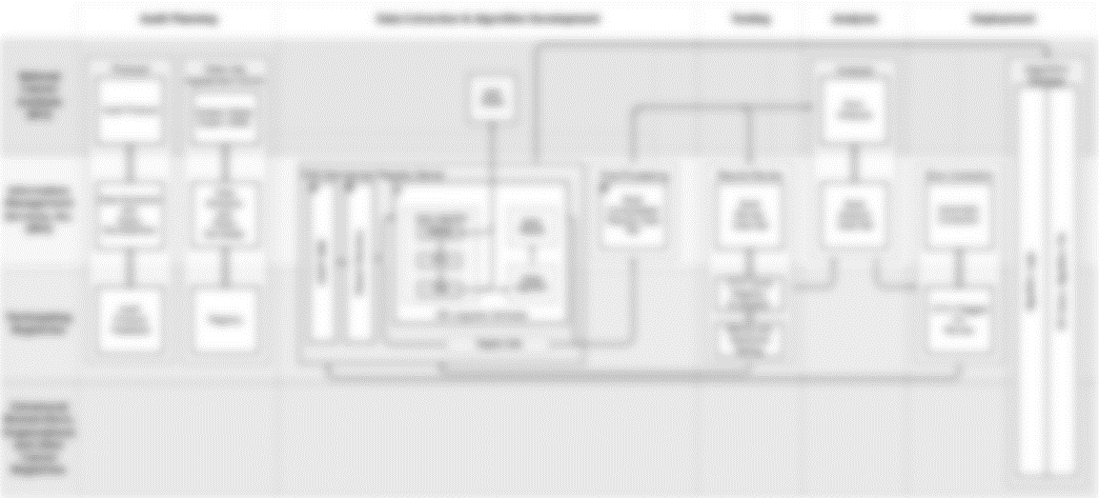

Data Extraction & Algorithm Development
Algorithm Development
I2E query developed on registry data
SME review as needed on test results
Mature algorithm deployed on registry data
Query results in a structured format sent for post-processing
Post-Processing
Linking consolidated values with relevant individual values extracted by query
Build testing set for metrics calculation and statistical testing
Build analytic data set for error analysis
A
B
C
D
E

Slide 10
Algorithm Development
Algorithm Development
REC-0123456789
BRESLOW
0.256 MM
SMEs provide clinical, pathological, and registrar expertise to guide development.
Summary of query logic:
  Find measurement values
  Determine relevancy to melanoma tumor depth
  Determine collaborative staging
  Determine if measurement part of range, e.g., “at least”
  Select records
  Extract measurements
REC-0567986788
BRESLOW
1.025 MM
...
...
MALIGNANT MELANOMA, SUPERFICIAL SPREADING TYPE TUMOR THICKNESS 0.256 MM (BRESLOW DEPTH):
…
…
REC-9164586991
BRESLOW
0.010 MM
REC-1112345800
BRESLOW
2.000 MM
MALIGNANT MELANOMA
REC-1000568070
BRESLOW
3.265 MM
REC-1986457612
BRESLOW
2.500 MM
TUMOR THICKNESS
0.256 MM
REC-6655888800
BRESLOW
5.000 MM
BRESLOW DEPTH
REC-1118855999
BRESLOW
9.500 MM
REC-1864555401
BRESLOW
1.110 MM
REC-0005648988
BRESLOW
0.550 MM
A
B
C
D
E
Notes:
Insert slides 14 and 15 from Georgetown Presentation here.

Slide 11
Algorithm Development
Post-Processing
Convert measurements to single measurement type, e.g., all millimeters.
Link extracted measurements with associated consolidated value for record(s).
Build analytic and review data sets for testing and analysis.
A
B
C
D
E

Slide 12
Develop
Review
Improve
New Data
Path Reports
TP
FP
Path Reports
Path Reports
Path Reports
Abstracts
Path Reports
FN
TN
1
2
3
4
Development Cycle
Notes:
Algorithm development
Developed on pathology reports (mostly text)
Further developed on abstracts
Algorithm results testing
Results throughout algorithm development checked against gold standard (CTC)
Error rates tracked throughout development
Post-processing
Results from I2E will undergo post-processing to produce a consolidated value
Mimics heuristic human registrars follow

Slide 13

Breslow’s depth
Patient has a Breslow’s depth of 2.50 mm at least
2.50
mm
Patient has a Breslow’s depth of 2.50 mm at least
at least
Path Reports
m
R
i
✓
u
x
Melanoma tumor depth not reported
Search Logic
Notes:
Algorithm logic
Find numeric value and associated unit of measurement
Determine relevancy to MTD
Check for associated numeric range phrases (e.g., at least)
If no numeric value found:
Determine document relevancy to MTD (collaborative staging)
Measurements and documents not meeting any of these criteria are not chosen.
Constraints (e.g., non-relevant words) are applied at the m and u step (first bubble).

Slide 14
Breslow’s depth
2.50
mm
at least
Patient ID | Tumor Record Number | Measurement | Unit | Quality 1 | Quality 2
A123 | 1 | 2.50 | MM | AT LEAST
A123 | 2 | 1.25 | MM
Path Reports
m
R
i
✓
u
B234 | 1 | 1.00 | MM
C354 | 1 | 0.75 | MM
x
Consolidated Data Set
Notes:
Data picked up by algorithm are structured as a table for post-processing.
Post-processing consolidates the measurements according to rules followed by registrars.
A consolidated data set will be used for the next phase where the machine generated values are compared to a data set re-consolidated by registrars.

Slide 15
 | CTC Code | No CTC Code
I2E Hit | 4754 7959 | 62 123
No I2E Hit | 1650 1584 | 529 569
 | CTC Code | No CTC Code
I2E Hit | 4754 7959 | 62 123
No I2E Hit | 1650 1584 | 529 569
 | CTC Code | No CTC Code
I2E Hit | 4754 7959 | 62 123
No I2E Hit | 1650 1584 | 529 569
 | CTC Code | No CTC Code
I2E Hit | 4754 7959 | 62 123
No I2E Hit | 1650 1584 | 529 569
 | CTC Code | No CTC Code
I2E Hit | 4754 7959 | 62 123
No I2E Hit | 1650 1584 | 529 569
Abstracts
Pathology Reports
Performance Metrics
Notes:
Based on hits returned not the patient level
Development on abstracts
Post-processing algorithm under development
Algorithm metrics

Slide 16
Abstracts
Pathology Reports
 | Path Reports
Recall | 70.13
Precision | 85.24
F-Score | 76.95
 | Path Reports
Recall | 70.13
Precision | 85.24
F-Score | 76.95
 | Path Reports
Recall | 70.13
Precision | 85.24
F-Score | 76.95
 | Path Reports
Recall | 70.13
Precision | 85.24
F-Score | 76.95
 | CTC Code | No CTC Code
I2E Hit | 4754 7959 | 62 123
No I2E Hit | 1650 1584 | 529 569
%
Recall, Precision, F-Score
Notes:
Based on hits returned not the patient level
Development on abstracts
Post-processing algorithm under development
Algorithm metrics

Slide 17
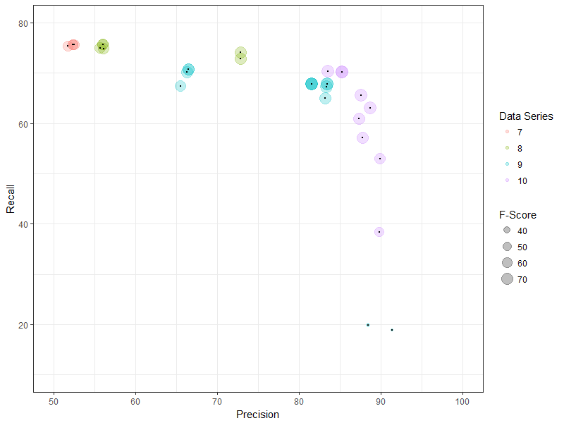
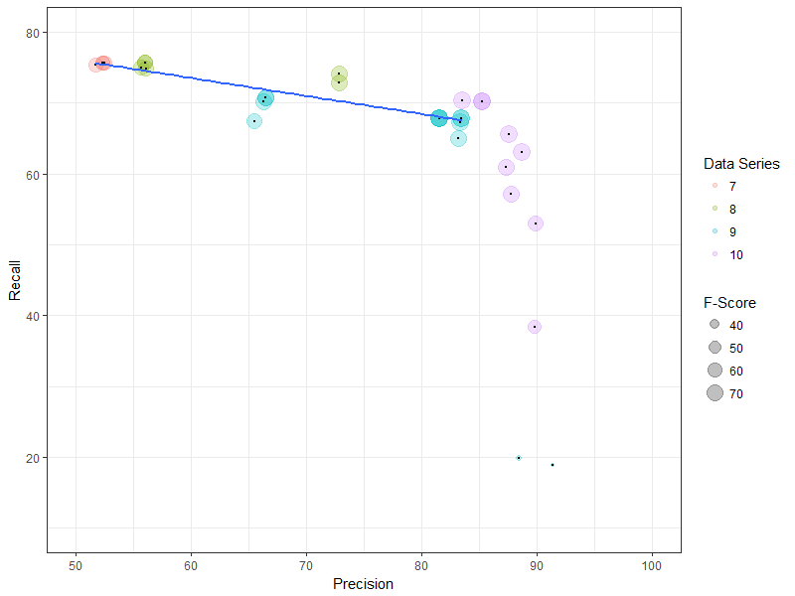
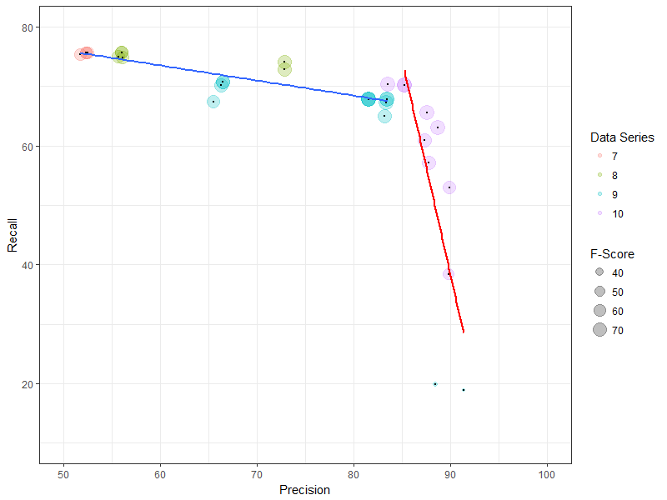
Cost of Increased Precision on Recall
Notes:
Recall cost for small increase in precision is great
Next focus on improving Recall

Slide 18
Breslow
Notes:
Most numeric measurements occurred immediately after the anchor term “Breslow”
Other anchor terms include: ‘[melanoma tumor] thickness’, ‘[tumor] depth’, ‘[melanoma tumor] invasion’

Slide 19
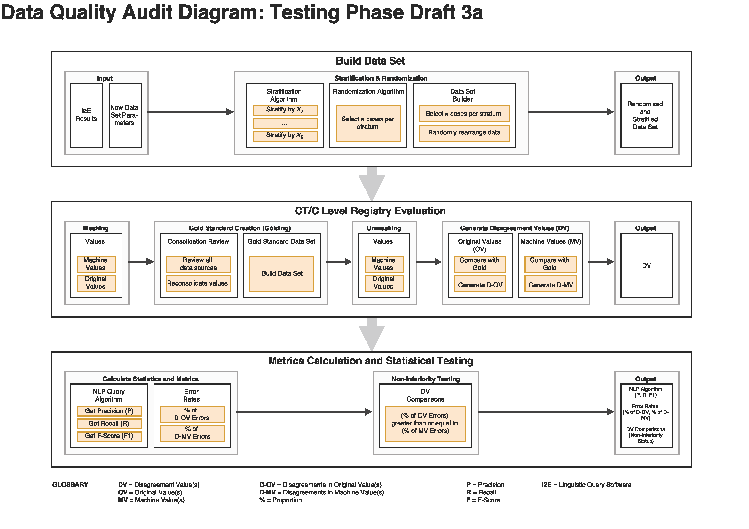
Testing
Build Data Set
Construction of randomized, stratified Review data set as subset of all I2E results in collaboration with a statistician for CT/C level registry evaluation
CT/C Level Registry Evaluation
Creation of reconsolidated values from CT/Cs in Review data set and disagreements between original and machine values
Metrics & Statistical Testing
Calculate performance metrics and perform non-inferiority testing
A
B
C
D
E

Slide 20
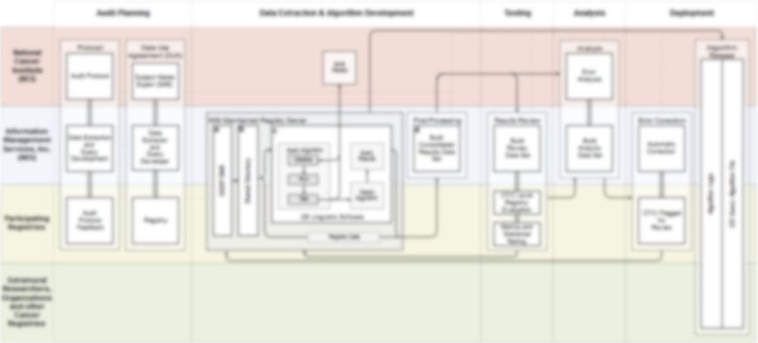
Review Data Set
Stratified & Randomized
Take in measurement results from I2E
Collaborate with statistician to randomly select cases for a subset according to certain strata (e.g., measurement range of x > 1 mm).
A
B
C
D
E

Slide 21
CT/C Level Registry Evaluation
Golding & Disagreement Values
Registrar to reconsolidate measurements for CT/Cs in Review data set for use as gold standard
  Predicted values are masked
Disagreements between gold values, original consolidated values, and machine predicted values calculated
A
B
C
D
E

Slide 22
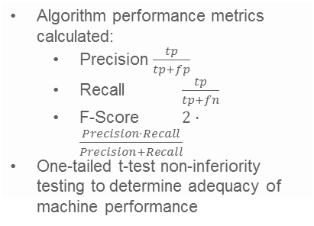
Metrics Calculation and Statistical Testing
Performance & Error Rates
Algorithm performance metrics calculated:
  Precision $\frac{tp}{tp+fp}$
  Recall $\frac{tp}{tp+fn}$
  F-Score $2⋅\frac{Precision⋅Recall}{Precision+Recall}$
One-tailed t-test non-inferiority testing to determine adequacy of machine performance
A
B
C
D
E

Slide 23

Analysis
Error Analysis
Categorize errors by error type
Categorize errors by source document
Categorize errors by demographic factors
Impact on Clinical Outcomes
Changes in stage before and after error correction
Changes in tumor depth measure before and after error correction
Impact on survival estimates
A
B
C
D
E

Slide 24
Deployment
Flagged Errors
Automatic correction of errors
CT/C flagged for review
Algorithm Release
Algorithm logic
I2E query algorithm file
A
B
C
D
E

Slide 25
Data Quality Audit Process Overview
A
B
C
D
E

